Slide 1
Link Analysis
Dr. A. Bhuvaneswari
Module 4

Slide 2
Road map
Link Analysis - Intro
HITS Algorithm
Co-citation and bibliographic coupling
PageRank
Summary

Slide 3
Introduction
From 1996, it became clear that content similarity alone was no longer sufficient.
The number of pages grew rapidly in the mid-late 1990’s.
Try “classification technique”, Google estimates: 10 million relevant pages.
How to choose only 30-40 pages and rank them suitably to present to the user?
Content similarity is easily spammed.
A page owner can repeat some words and add many related words to boost the rankings of his pages and/or to make the pages relevant to a large number of queries.

Slide 4
Introduction (cont …)
During 1997-1998, two most influential hyperlink based search algorithms PageRank and HITS were reported.
Both algorithms are related to social networks. They exploit the hyperlinks of the Web to rank pages according to their levels of “prestige” or “authority”.
HITS: Jon Kleinberg (Cornel University), at Ninth Annual ACM-SIAM Symposium on Discrete Algorithms, January 1998
PageRank: Sergey Brin and Larry Page, PhD students from Stanford University, at Seventh International World Wide Web Conference (WWW7) in April, 1998.
PageRank powers the Google search engine.

Slide 5
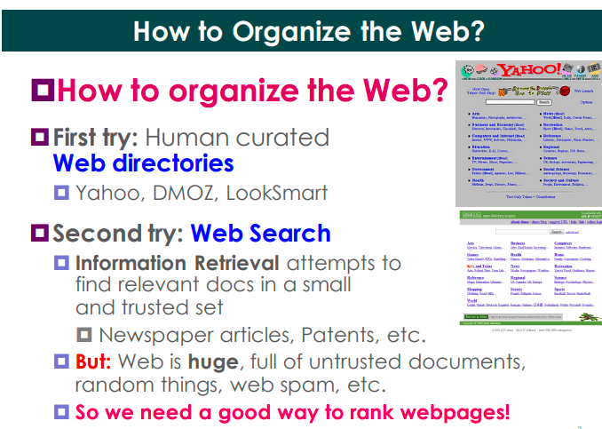

Slide 6
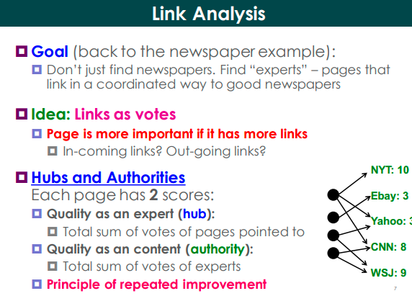

Slide 7
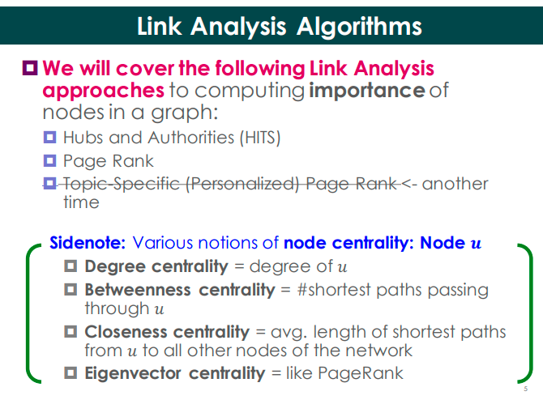

Slide 8
THE HITS ALGORITHM
Hypertext Induced Topic Search

Slide 9
Link analysis: hubs and authorities
Authorities
Authorities are web pages cited by many different hubs
Good authorative pages are reliable sources of information about a given topic
Using the network parlance, authorities are nodes receiving many inward links
The relevance of an authority is “measured” by the number of inward links
Hubs
Hub can be understood as a web page that points to many other web pages or, in other words, as a compilation of web pages that address a specific topic
Using the network parlance, hub is a node with many outward links
A good hub is a site that points to good authorative sites

Slide 10
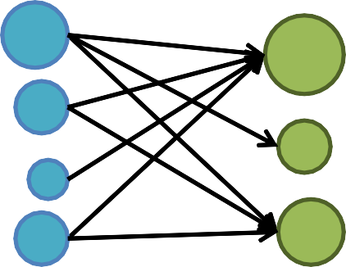
High hub score
A
1
High authority score
B
Hubs
2
Authorities
C D
3

Slide 11
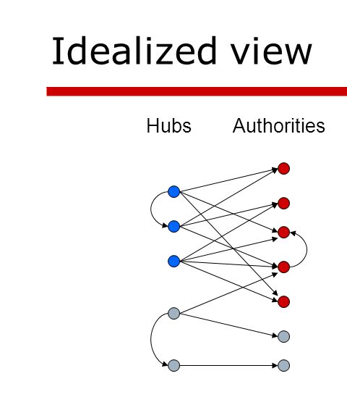

Slide 12
Link analysis: hubs and authorities
1. HITS algorithm
HITS algorithm
HITS (Hypertext Induced Topic Selection) is a link analysis algorithm developed by Kleinberg (1999)
HITS computes and returns 2 scores, for each node v in the network: the authority
score auth(v) and the hub score hub(v)
These scores provide information about the potential of each node to be an authority
or a hub, thus indicating how valuable is the information carried by it

Slide 13
Link analysis: hubs and authorities
1. HITS algorithm
HITS algorithm
HITS is an iterative algorithm based on the repeated update of two basic rules:
Authority Update Rule: for each page p (or node v), update auth(p) to be the sum of the hub scores of all pages that point to it. A high authority score is assigned to p if it is linked to pages that are recognized as important hubs of information.
Hub Update Rule: for each page p (or node v), update hub(p) to be the sum of the authority scores of all pages that it points to. A high hub score is assigned to p if it links to nodes that are considered to be authorities in a given topic.

Slide 14
Link analysis: hubs and authorities
HITS algorithm
Given a query (topic) Q, collect the root set of pages S={s1, s2, s3,…, sn}
Set S is expanded to set T= S U {d|s->d or d->s, s є S}
Initialization: start with auth(p) = 1 and hub(p) = 1, for every p є T, and choose
the number of iterations k
Run the Authority Update Rule
Run the Hub Update Rule
Repeat k times the previous steps (2 and 3)
At the end, is common to normalize the values of both auth(p) and hub(p), due to their tendency to grow and become very large. The normalization consists in dividing the authority score (the hub score) by the sum of the squares of all authority scores (all hub scores).

Slide 15
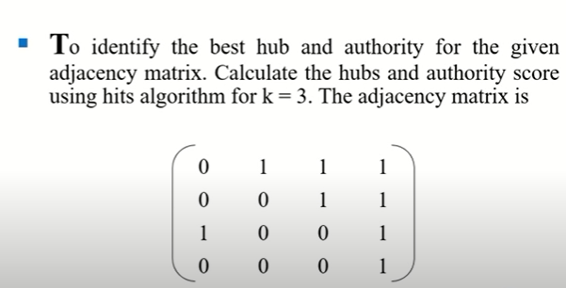
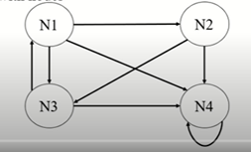

Slide 16
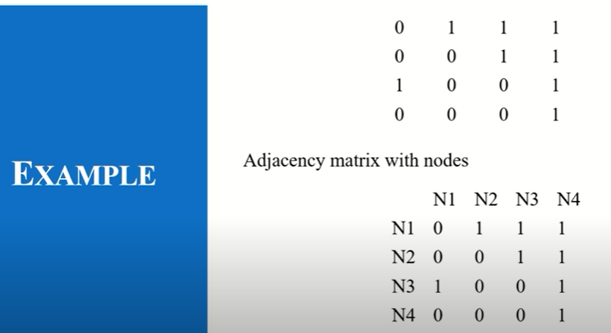

Slide 17
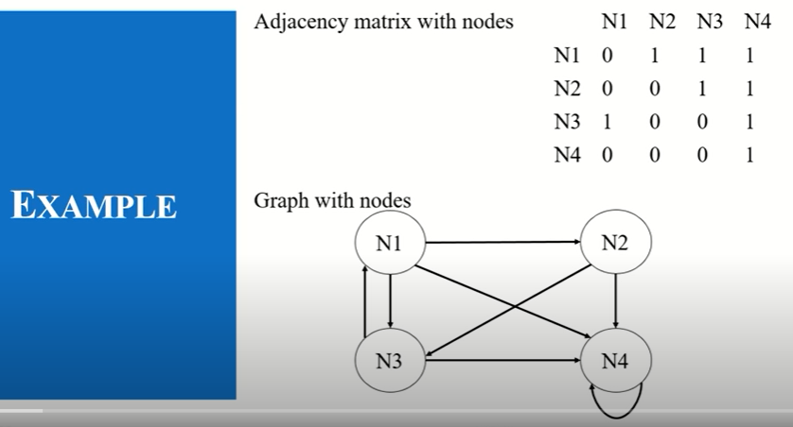

Slide 18
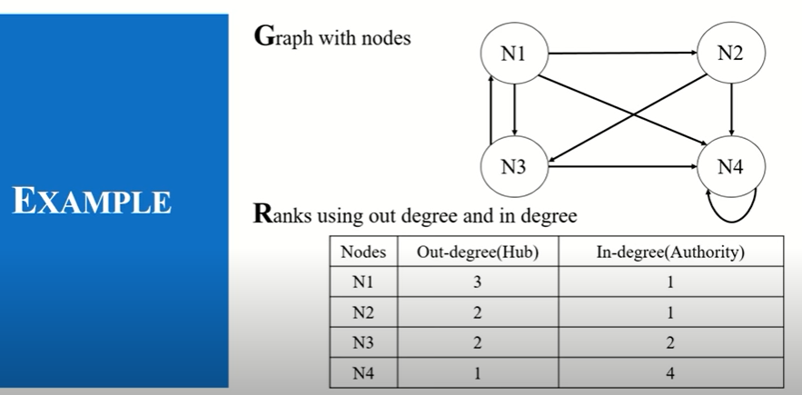

Slide 19
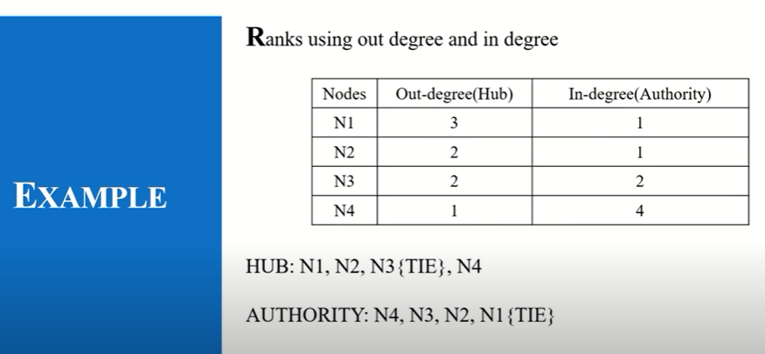

Slide 20
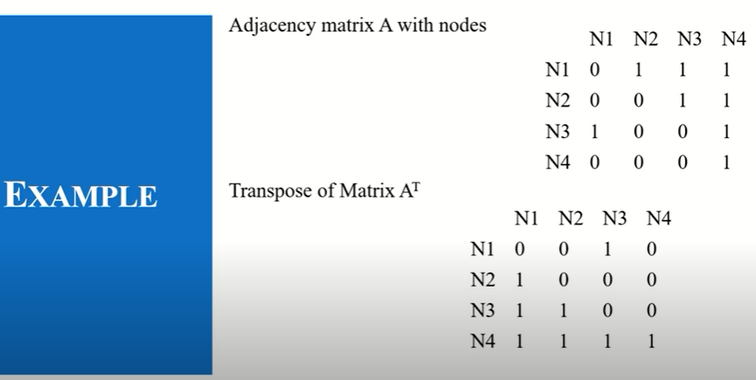

Slide 21
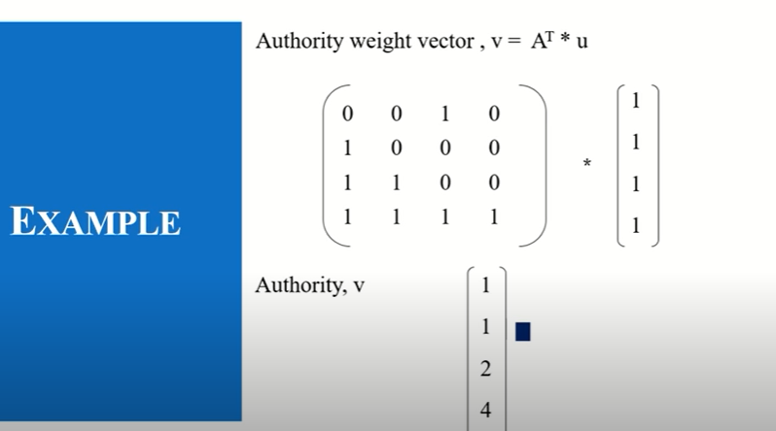

Slide 22
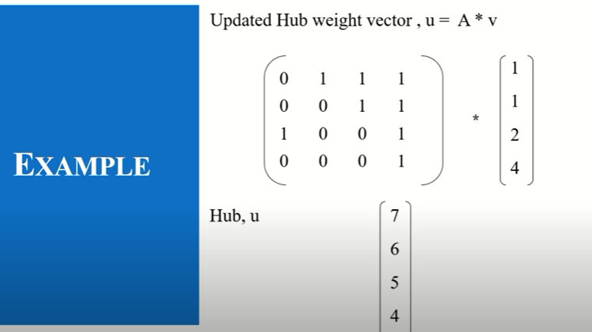

Slide 23
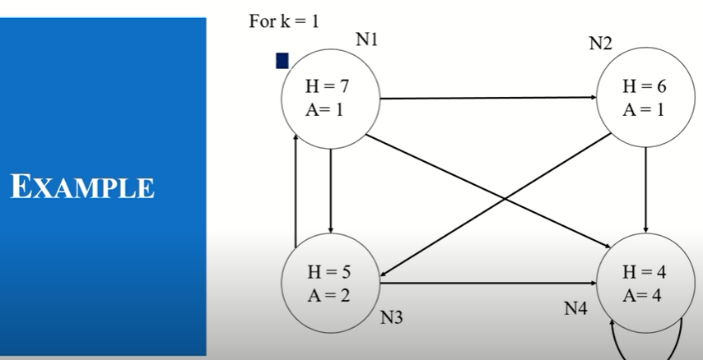

Slide 24
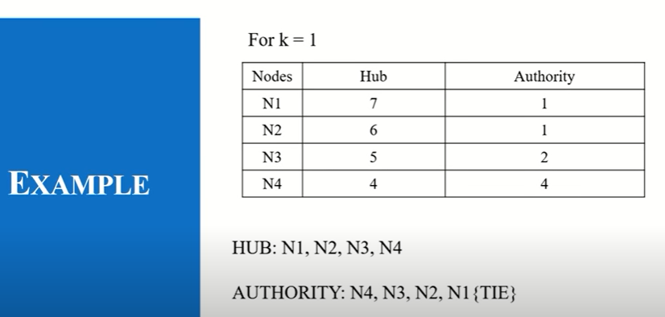

Slide 25
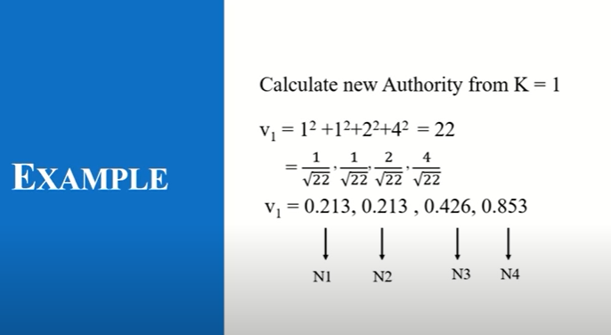

Slide 26
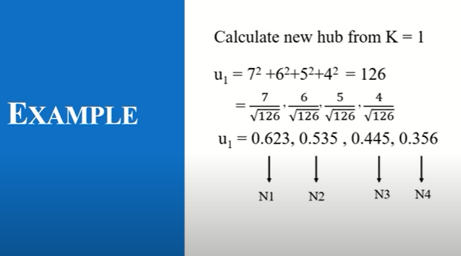

Slide 27
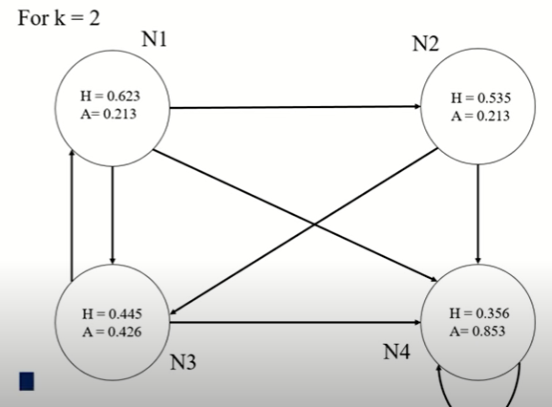

Slide 28
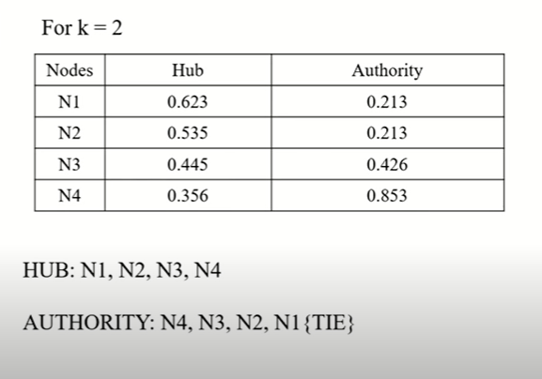

Slide 29
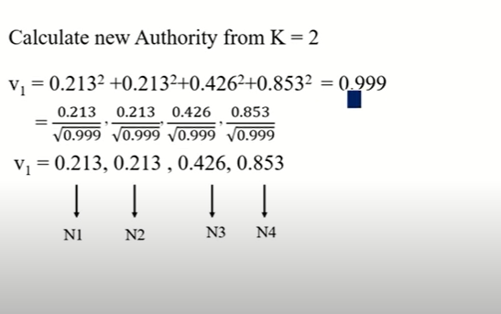

Slide 30
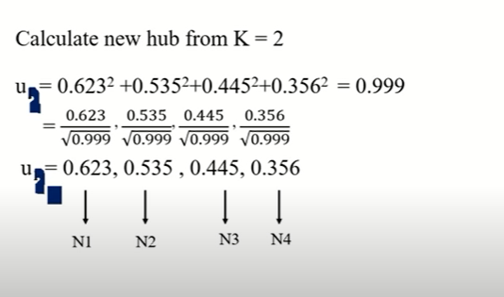

Slide 31
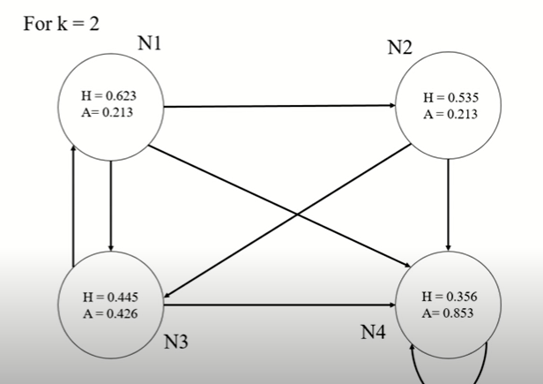

Slide 32
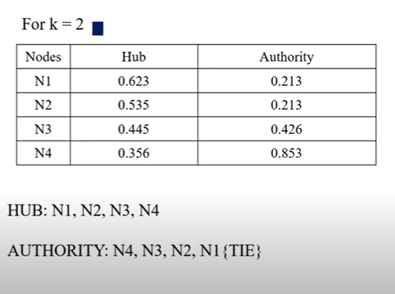

Slide 33
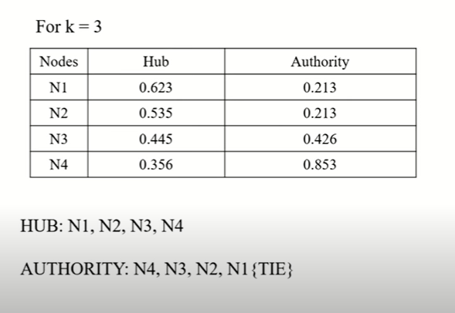

Slide 34
Road map
Introduction
Link analysis
Co-citation and bibliographic coupling
PageRank
HITS
Summary

Slide 35
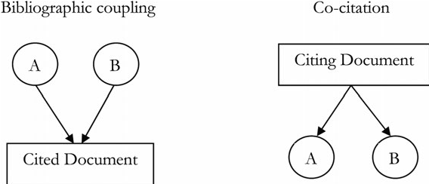
Co-citation and Bibliographic Coupling
Another area of research concerned with links is citation analysis of scholarly publications.
A scholarly publication cites related prior work to acknowledge the origins of some ideas and to compare the new proposal with existing work.

Slide 36
Co-citation and Bibliographic Coupling
When a paper cites another paper, a relationship is established between the publications.
Citation analysis uses these relationships (links) to perform various types of analysis.
We discuss two types of citation analysis, co-citation and bibliographic coupling. The HITS algorithm is related to these two types of analysis.

Slide 37
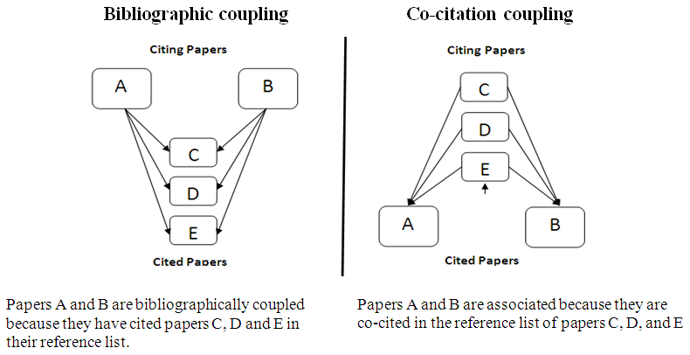

Slide 38
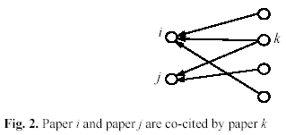
Co-citation
If papers i and j are both cited by paper k, then they may be related in some sense to one another.
The more papers they are cited by, the stronger their relationship is.

Slide 39
Co-citation
Let L be the citation matrix. Each cell of the matrix is defined as follows:
L_{ij} = 1 if paper i cites paper j, and 0 otherwise.
Co-citation (denoted by C_{ij}) is a similarity measure defined as the number of papers that co-cite i and j,
C_{ii} is naturally the number of papers that cite i.
A square matrix C can be formed with C_{ij}, and it is called the co-citation matrix.

Slide 40
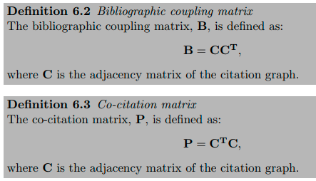
Co-citation Coupling

Slide 41
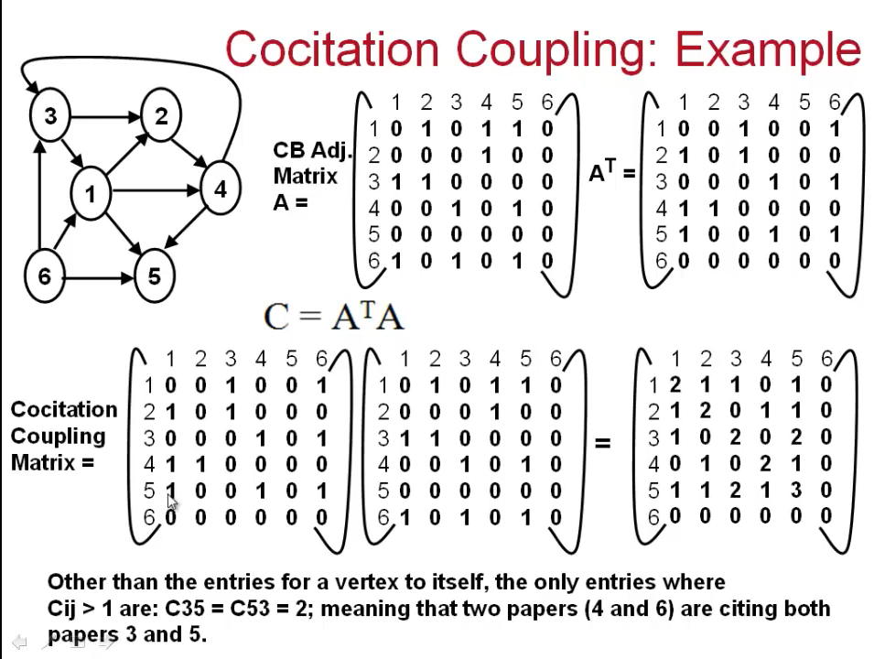

Slide 42
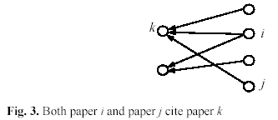
Bibliographic coupling
Bibliographic coupling operates on a similar principle.
Bibliographic coupling links papers that cite the same articles
if papers i and j both cite paper k, they may be related.
The more papers they both cite, the stronger their similarity is.

Slide 43
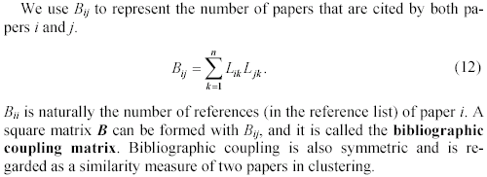
Bibliographic coupling (cont …)

Slide 44
Bibliographic coupling

Slide 45
